Slide 1

Customer Shopping Behavior Analysis
Uncovering insights from 3,900 purchases to guide strategic business decisions

Slide 2

DATASET OVERVIEW
The Foundation
3,900
18
50
Total Purchases
Data Points
Locations
Transactions analyzed across all categories
Columns tracking customer behavior
Geographic distribution of customers
25
Product Types
Diverse item catalog analyzed

Slide 3

PYTHON ANALYSIS
Data Preparation Journey
01
02
03
Data Loading & Exploration
Missing Data Handling
Feature Engineering
Imported dataset, checked structure with df.info() and summary statistics
Imputed 37 missing Review Ratings using median by category
Created age_group bins and purchase_frequency_days columns
04
05
Data Consistency
Database Integration
Standardized columns to snake_case, dropped redundant promo_code_used
Connected to PostgreSQL for advanced SQL analysis

Slide 4
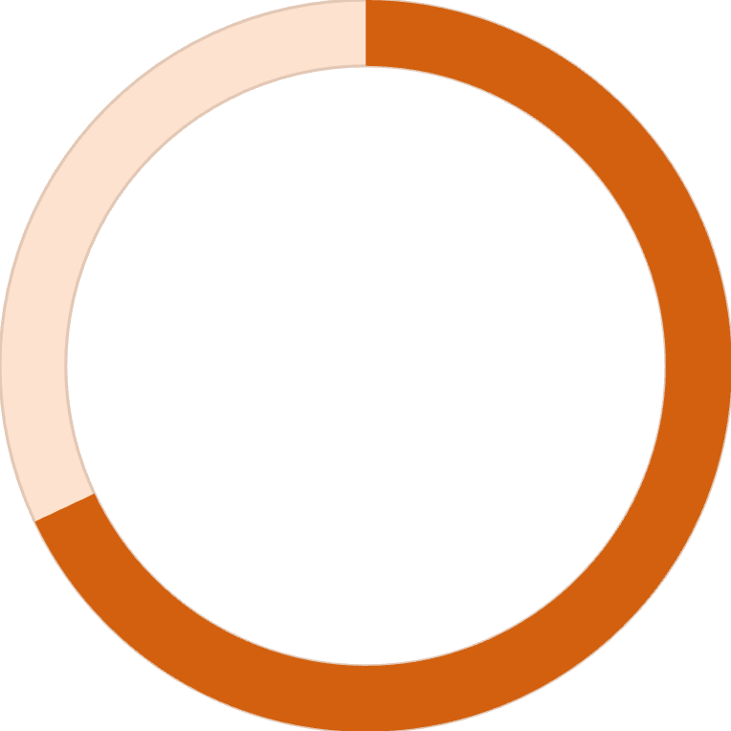
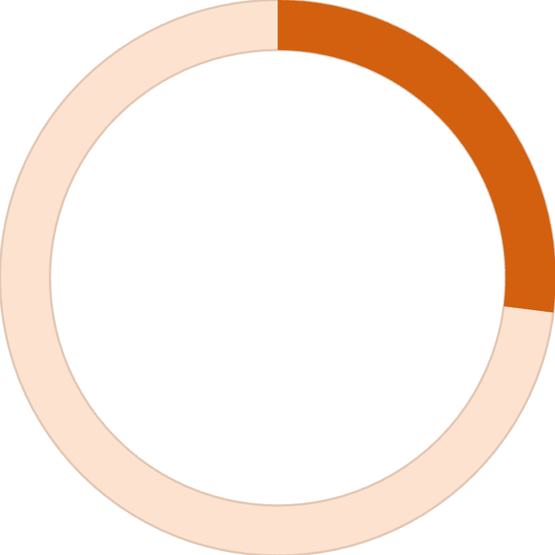
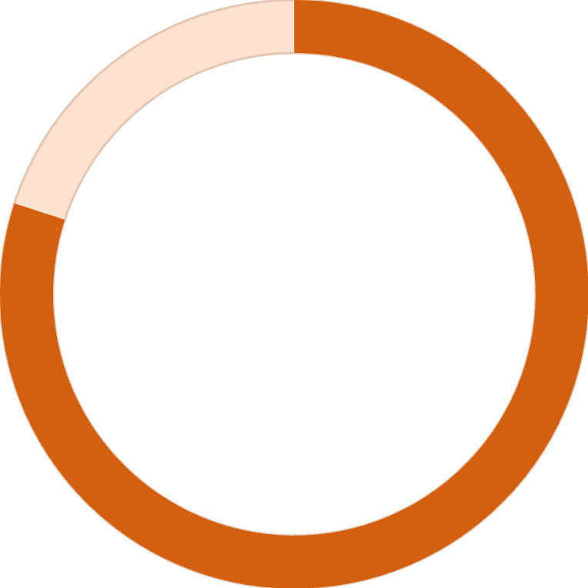
SQL INSIGHTS
Key Customer Metrics
Average Purchase Amount
Average Review Rating
$59.76
3.75 / 5.0
Consistent spending across customer base
Strong customer satisfaction overall
68%
27%
80%
Male Customers
Subscribers
Loyal Customers
Dominant demographic segment
Significant growth opportunity
Strong retention foundation

Slide 5
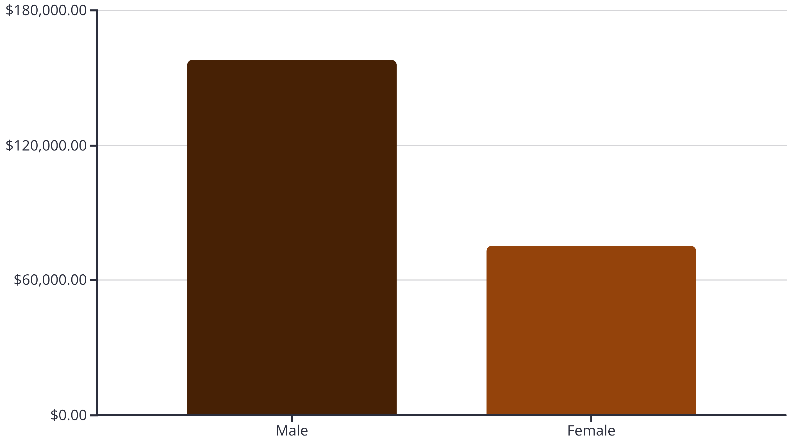
Revenue Analysis
Male customers generate 2.1x more revenue than female customers, representing a significant market concentration

Slide 6

PRODUCT PERFORMANCE
Top Products by Category
Clothing
1
Blouse - 171 orders
Pants & Shirt close behind
Accessories
2
Jewelry - 171 orders
Sunglasses & Belt equally popular
Footwear
3
Sandals - 160 orders
Highest average rating: 3.84
Outerwear
4
Jacket - 163 orders
Coat follows at 161 orders

Slide 7




Customer Segmentation
New
1
83 customers
2
Returning
701 customers
3
Loyal
3,116 customers
80% of customers are loyal, demonstrating strong retention but limited new customer acquisition
Subscription Impact
Subscribers: $59.49 avg spend
Non-subscribers: $59.87 avg spend
Minimal spending difference suggests untapped subscription value proposition

Slide 8
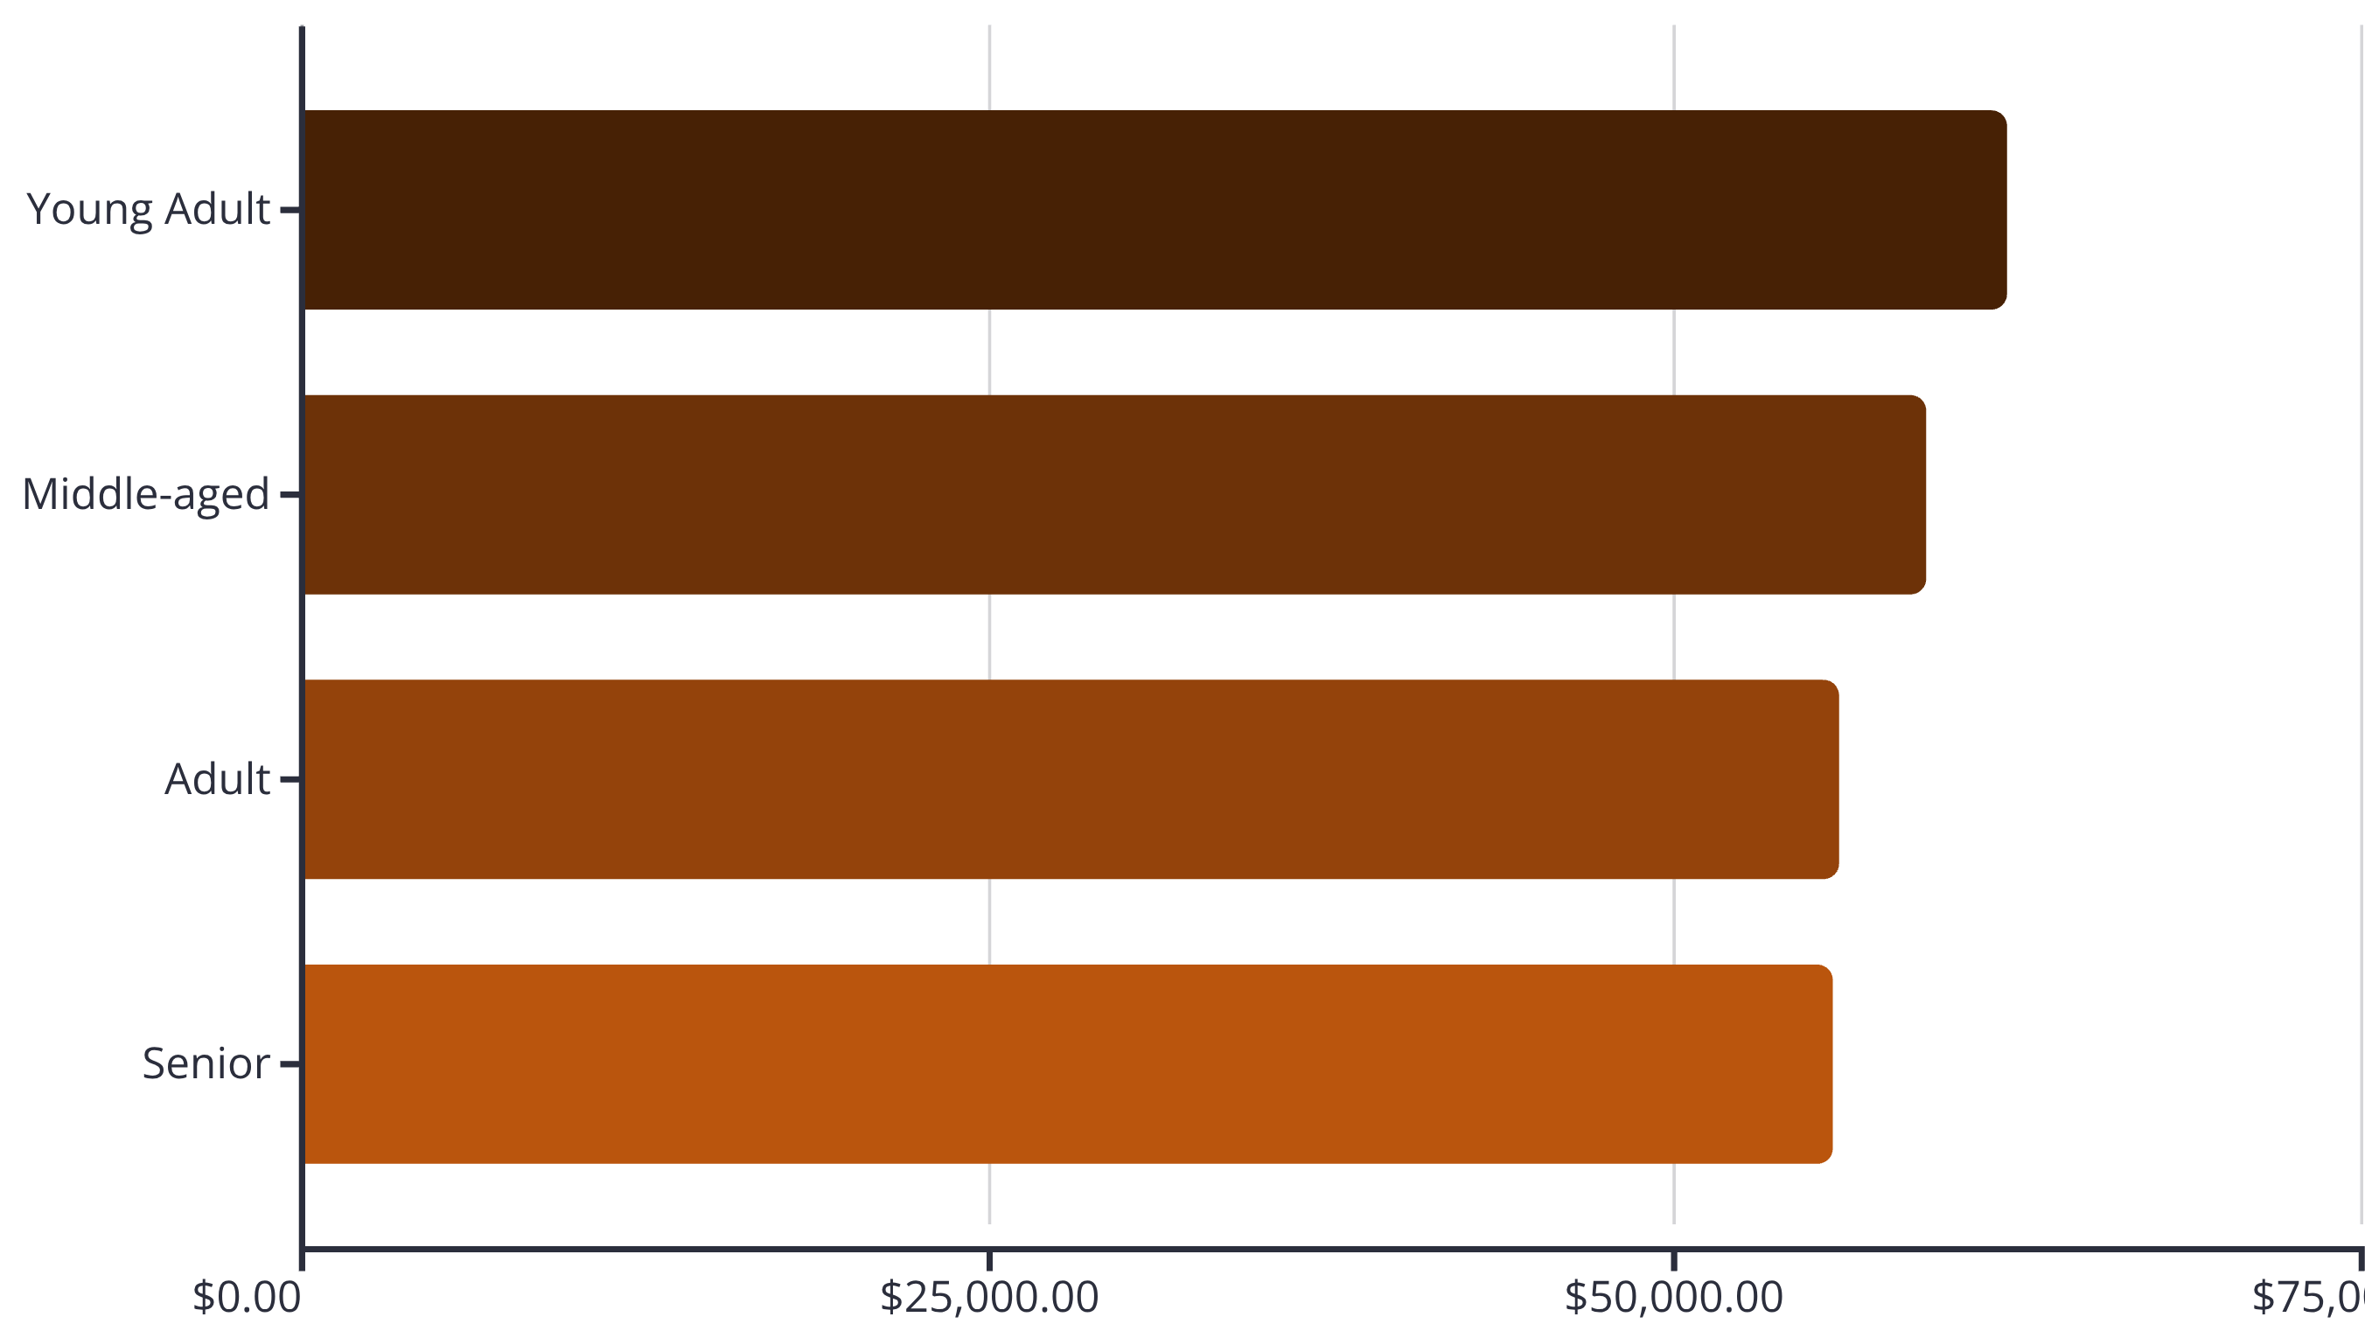
AGE DEMOGRAPHICS
Revenue by Age Group
Young Adults lead revenue generation, but distribution is relatively balanced across all age groups

Slide 9

Discount & Shipping Insights
High-Value Discount Users
Discount-Dependent Products
839 customers used discounts but spent above average
Hat: 50% discount rate
Discounts drive volume without sacrificing quality buyers
Sneakers: 49.66%
Coat: 49.07%
Shipping Preferences
Express: $60.48 avg
Standard: $58.46 avg
Express users spend slightly more per transaction

Slide 10





ACTION PLAN
Strategic Recommendations
Boost Subscriptions
Promote exclusive benefits to convert 73% non-subscribers
Loyalty Programs
Reward repeat buyers to strengthen 80% loyal customer base
Optimize Discounts
Balance promotional sales with margin control on high-discount items
Highlight Top Products
Feature high-rated items like Sandals (3.84) and Gloves (3.86) in campaigns
Targeted Marketing
Focus on Young Adults and express-shipping users for maximum ROI

